Slide 2
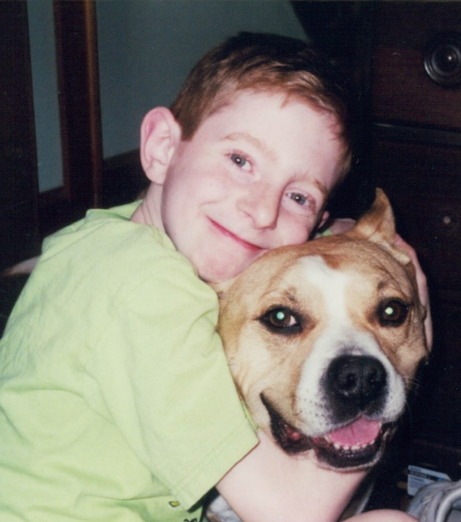
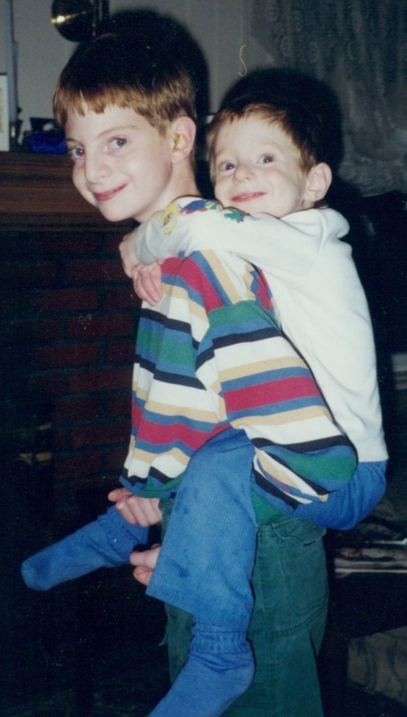
Notes:
Jane

Slide 3
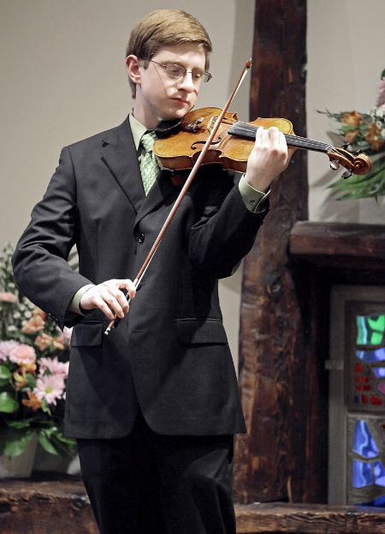
Notes:
Jane

Slide 4
Get Involved:
To bring the #Day1 Campaign to your school/organization visit www.day1campaign.com
to sign up as an upstander and download the #Day1 script.

Slide 5
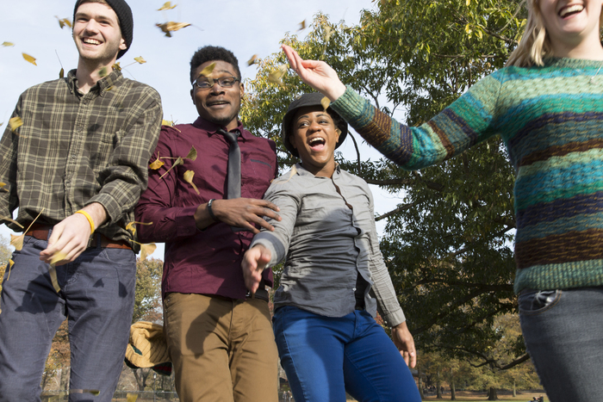
Turning Bystanders into Upstanders
http://www.tylerclementi.org/pledge

Slide 6
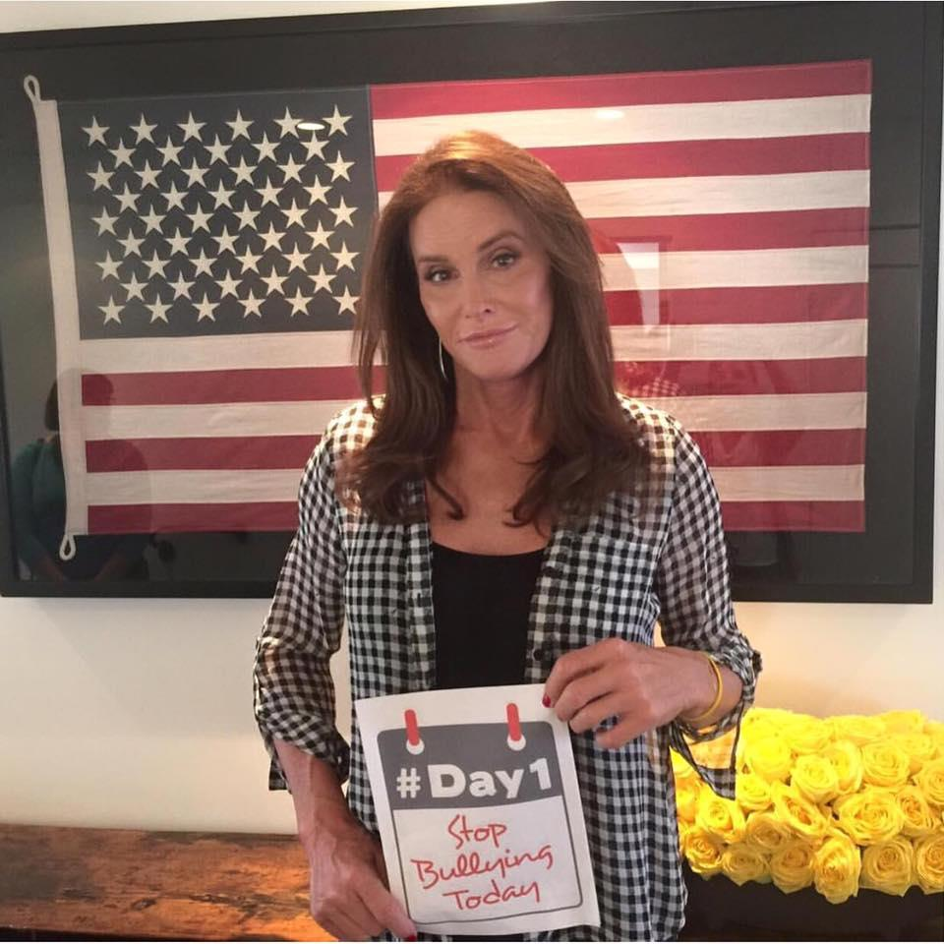
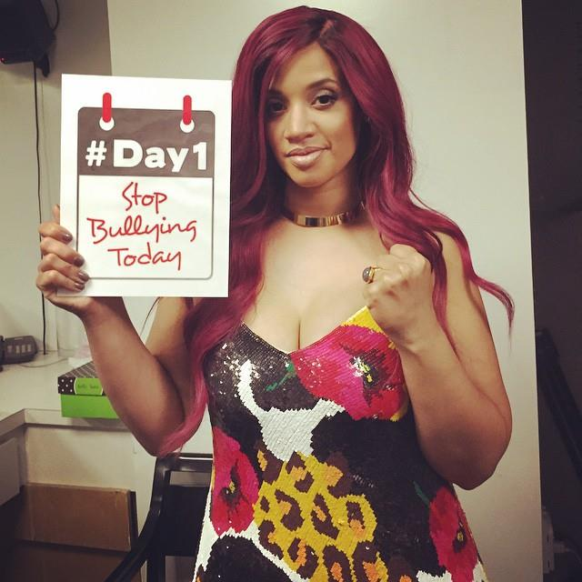
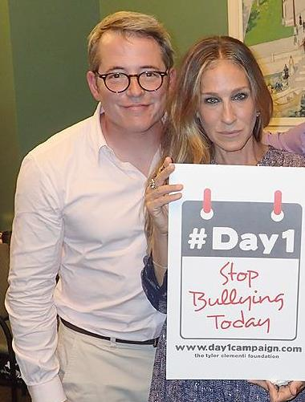
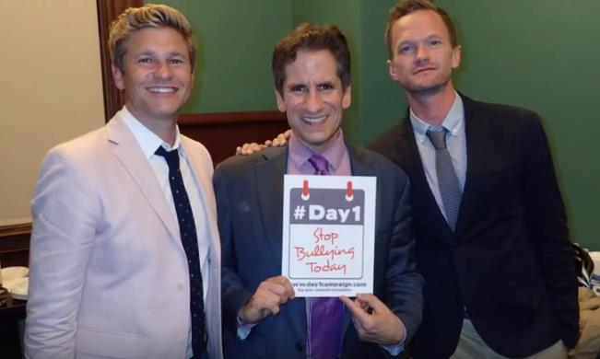
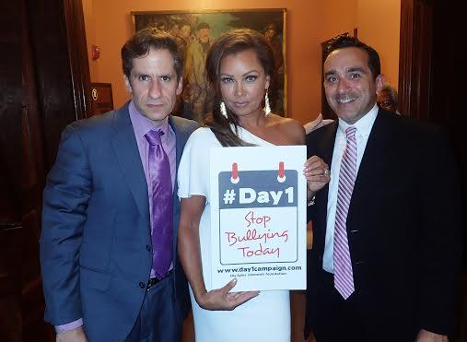
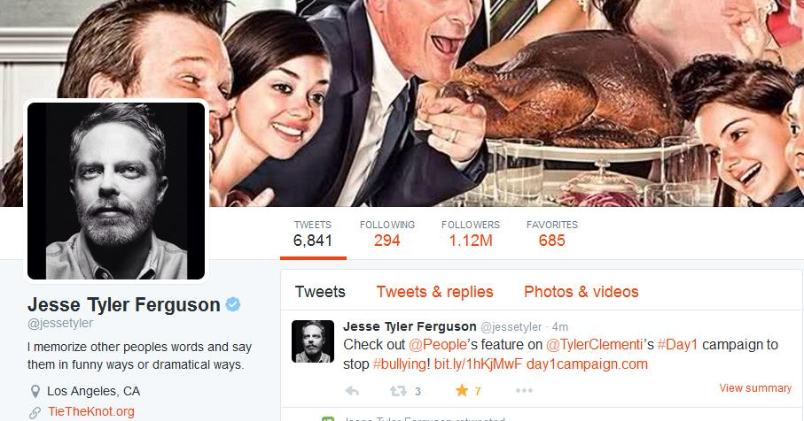
Notes:
Dascha Polanco from Orange is the New Black,
Caitlyn Jenner,
Matthew Broderick and Sarah Jessica Parker,
Vanessa Williams,
Neil Patrick Harris and husband, David Burtka
Jesse Tyler Ferguson from modern family tweet

Slide 9
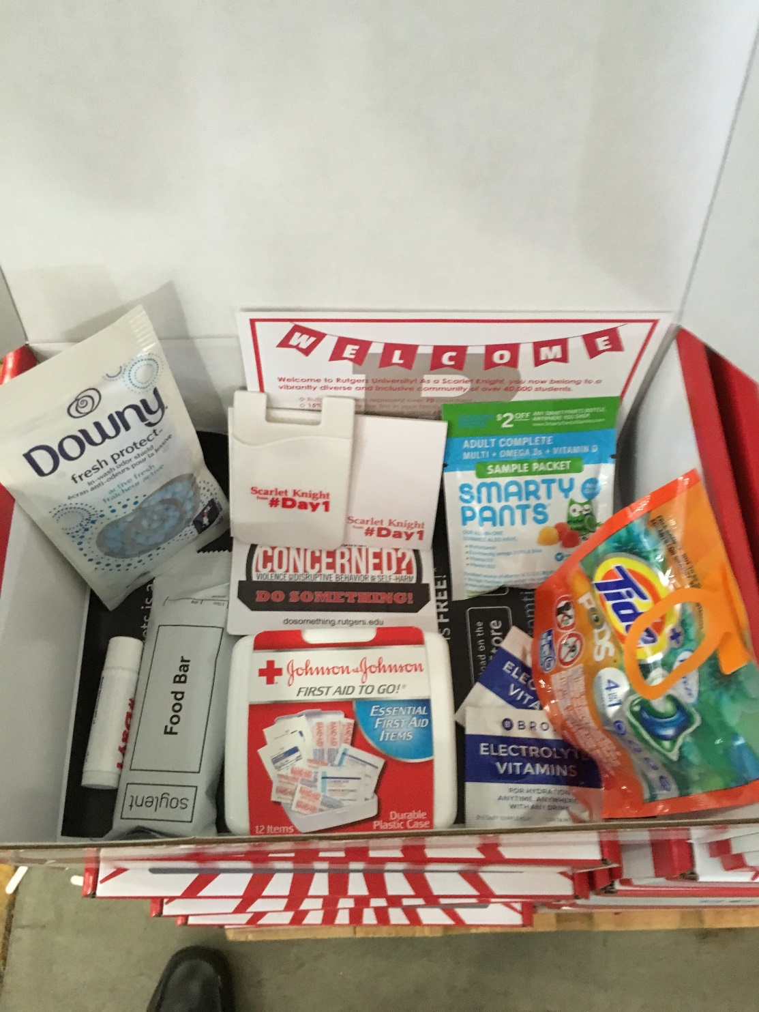
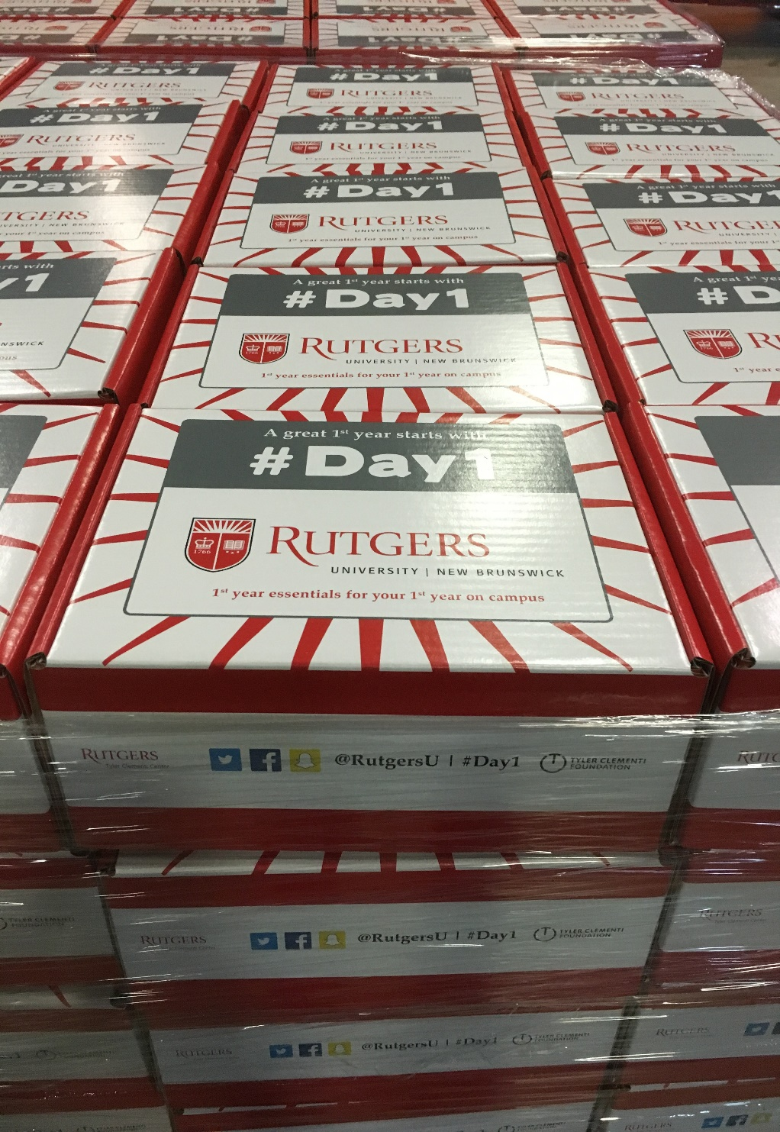

Slide 11
Stay Connected….
twitter.com/TylerClementi
Instagram.com/tyler_clementi_foundation/
facebook.com/TheTylerClementiFoundation
www.tylerclementi.org

